Slide 1
FinHeartBel
Marko, Nathan & Mo

Slide 2

Shocking Facts all around the world
1 out of 18 has Cardiac Arrhythmia worldwide.
Cardiovascular diseases are the leading cause of death in the EU.
(2013 = 37,5%)
Heart disease is the number 1 death cause in Russia.
Approximately 500.000 Americans die every year from a heart disease, Cardiac Arrhythmia causes the majority of that.
18% of all deaths in South Africa are cause by Cardiovascular diseases.
Notes:
nathan

Slide 3

The Idea
Inform people in advance and offer them a simple solution. Keeping track of their health with FinHeartBel.

Slide 4

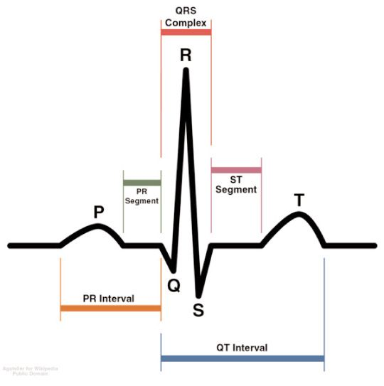
QRS complex
Notes:
mo

Slide 5
Algorithm
Custom C to Typescript port
Client-based implementation
Frequency independant
Portable to other projects and devices
Implementation of HC Chen, SW Chen, University of Taiwain
Algorithm based on Pan-Tompkins 1982
Notes:
mo

Slide 6
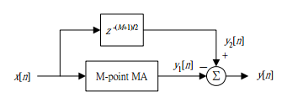
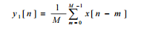
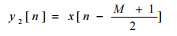
Highpass linear regression
moving average filter
Filter noise from Arduino
Preparing stage for lowpass filter
Notes:
mo

Slide 7
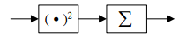
Lowpass stage
Emphisize peaks
Squaring function
Notes:
mo

Slide 8

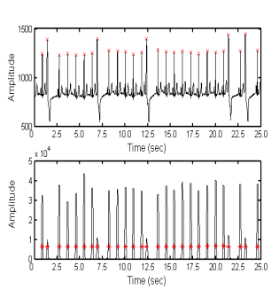
Decisionmaking stage
Detecting peaks
Frequency independant
Arrythmia decision making
BPM Calculation
Notes:
mo

Slide 9
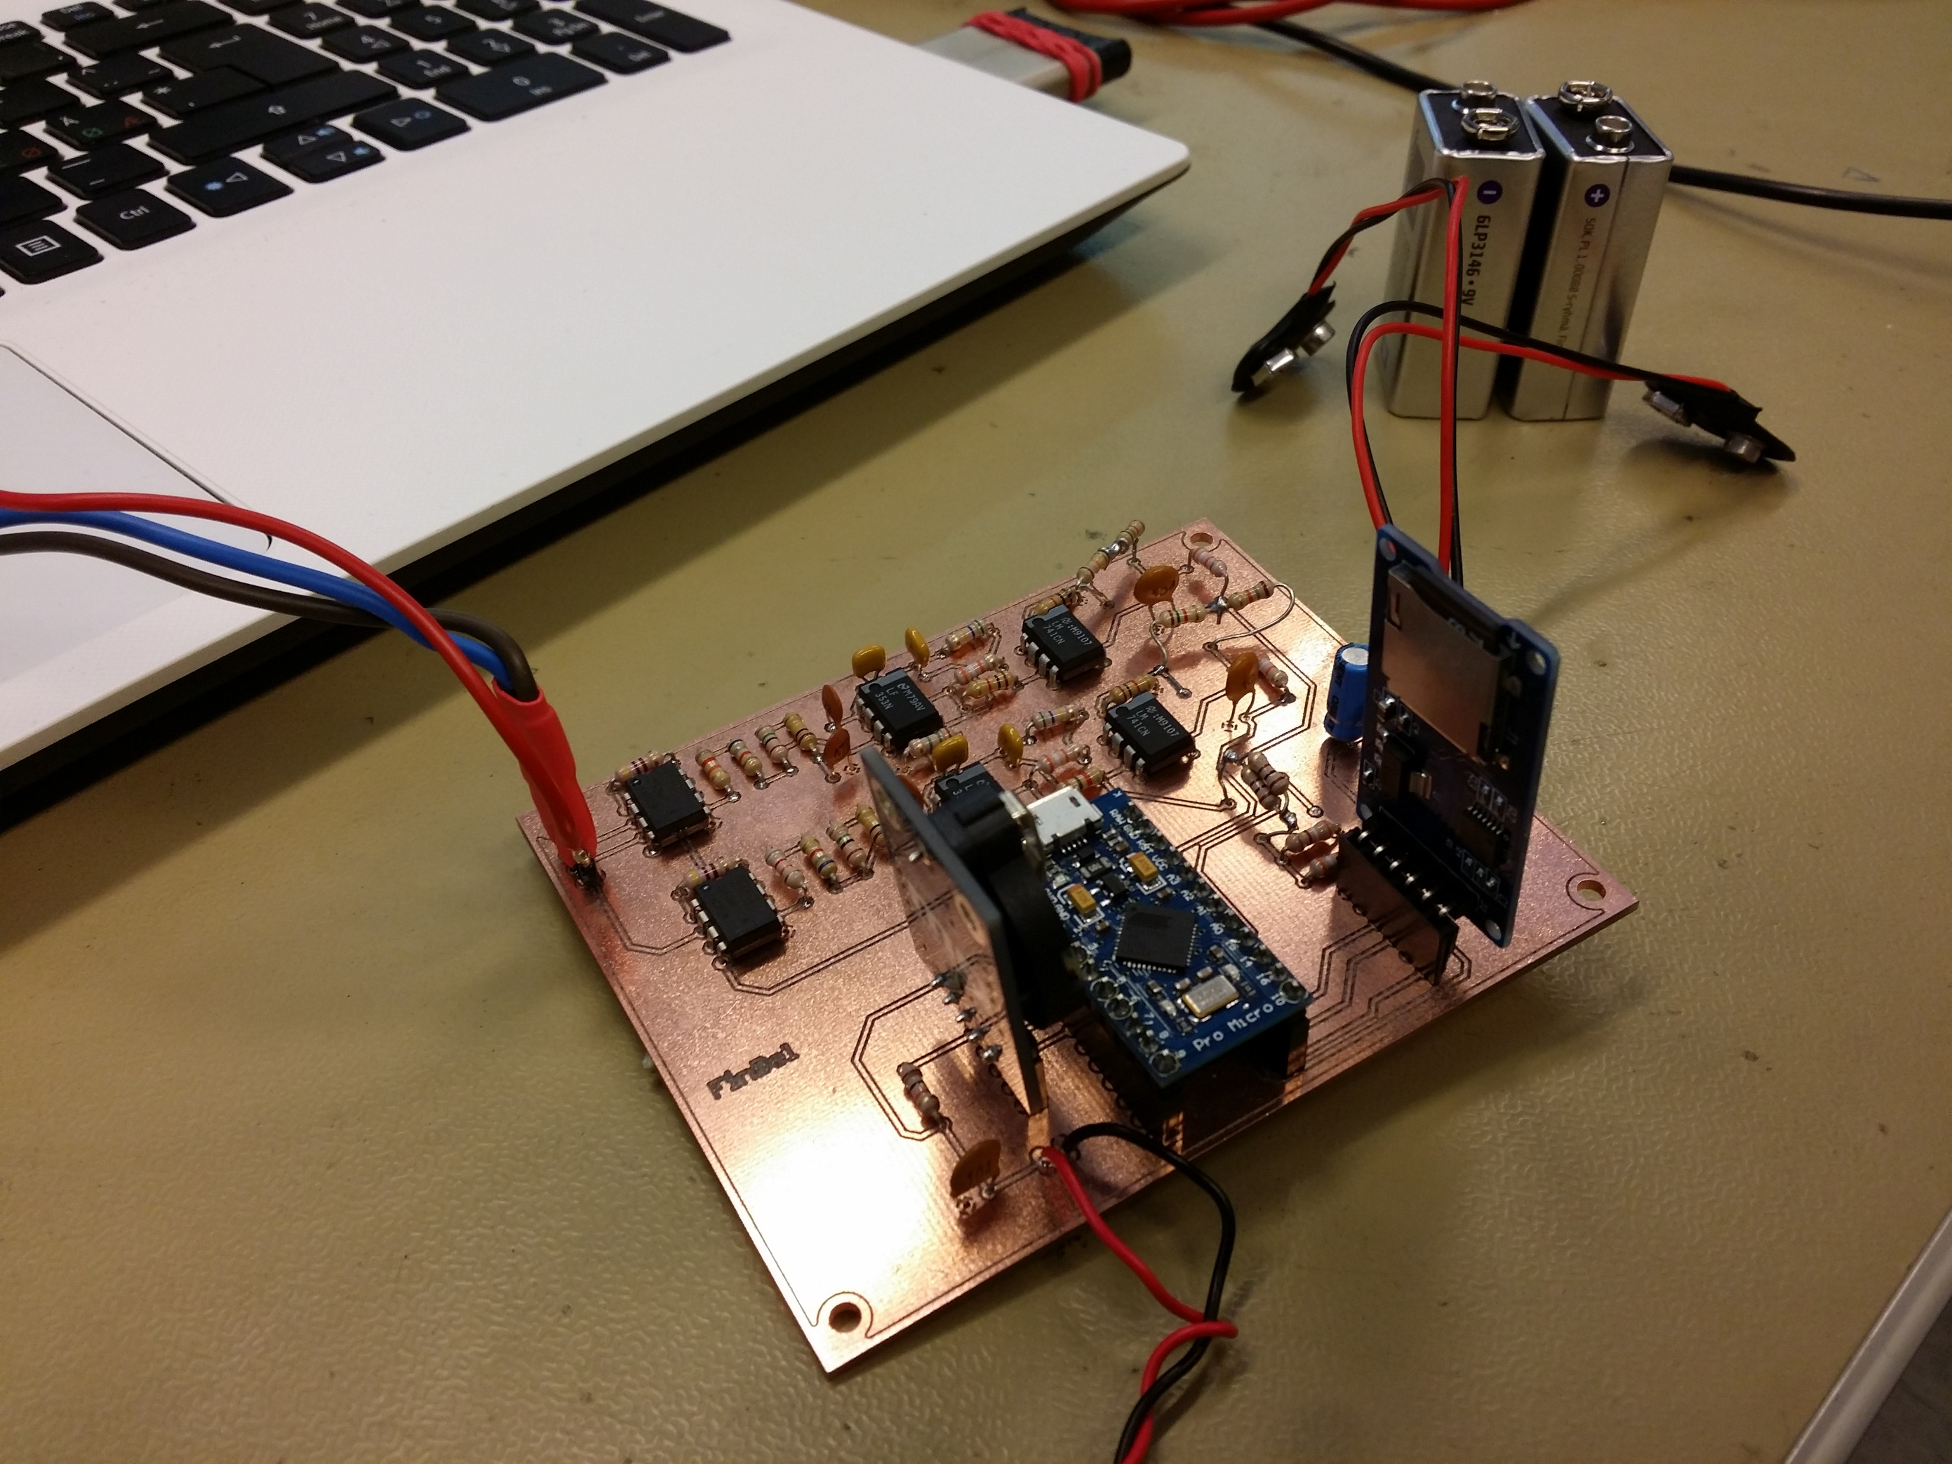
Hardware
Amplifier
Filter
Raise of voltage level
RC filter
A/D conversion
SD card
Notes:
marko

Slide 10
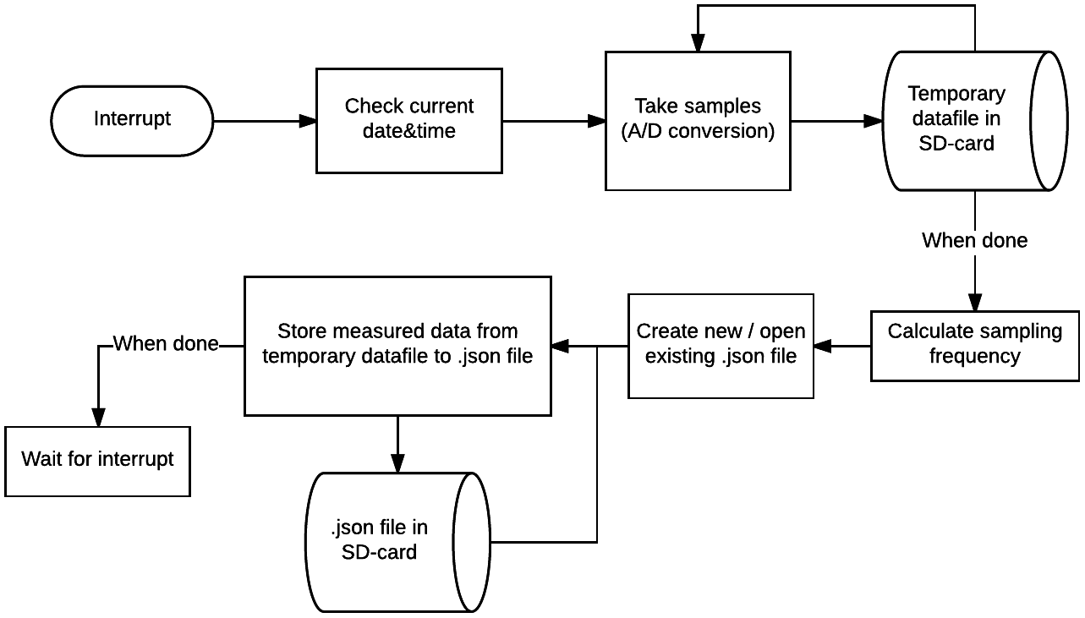
Notes:
marko

Slide 11
OUR PROCESS IS EASY
Measurements with device
Analyze with our algorithm
Show metrics to user
Notes:
Nathan & mo

Slide 12


FinHeartBel
Place your screenshot here
Demonstration

Slide 13
Goals & achievements
User system
hardware independent algorithm for QRS detection
Extendable toolkit for webdevelopers

Slide 14

THANKS!
Any questions?
You can contact us:
nathan.aertgeerts@student.ap.be
mo.bouzim@student.ap.be
t5ylma01@students.oamk.fi

Slide 15

CREDITS
Special thanks to all the people who helped making this possible:
Tom & Luc Peeters
Pekka Alaluukas & Jaakko Kaski
Marko & Veli-Pekka, Nathan & Mo

